Slide 1
Predicting High School Graduation Rates
By: Kevin Bryson

Slide 2
Problem
What are the important variables in determining high school graduation rates?
Use these variables to predict future high school graduation rates.
Make recommendations to stakeholders including school districts and other organizations that can increase graduation rates incorporating these variables.

Slide 3
Introduction
One of the biggest challenges that each school district faces is how to increase graduation rates.
School district programs are audited to judge their effectiveness, however, most are not replaced.
School districts would be able to judge programs more effectively if there was a comprehensive analysis of data.
School Districts, Government Agencies and Education focused businesses would be our major clients.

Slide 4
Data Sources
California Department of Education.com
www.kidscount.org

Slide 5
Datasets
Graduation Rates by Gender and Ethnicity
Median Household Income
Poverty Rates
Unemployment Rates
Insurance Coverage Rates
Rent to Income Ratio
Cohort Graduation Rate
Number Of Health Centers per County
* All datasets were wrangled and cleaned eliminating all null values and then merged together into a final matrix (m5)

Slide 6
Data Analysis
The most important variables seem to be gender, and insurance rates.
Females had a positive correlation of 0.38 and males had a negative correlation of -0.34.
San Bernardino County Insurance percentage had a 0.25 correlation.

Slide 7
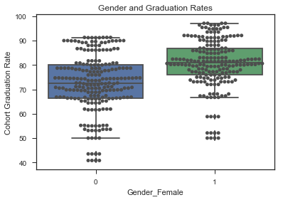
Comparing Graduation Rates
According to the boxplot, females have a higher graduation mean than that of their male counterparts.
Research over the last few years has shown a decrease in overall male graduation rates.
Male focused programs have not be instituted at a fast enough rate to change graduation rates.

Slide 8
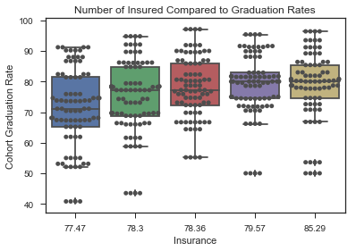
Graduation Rate and Number of Insured
Using the boxplot/scatterplot, there is positive correlation between the number of insured students and the graduation rate.
This correlation shows that healthy students would tend to perform better in school.
Other factors that insured students might improve would be attendance rates.

Slide 9
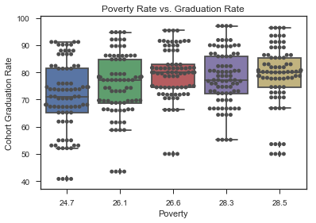
Effects of Poverty on Graduation Rates
According to the graph, poverty rates have a slight correlation with graduation rates.
Lower poverty has a lower mean graduation rate compared to higher poverty

Slide 10
Machine Learning Model
Picked two regression models (Linear Regression and Lasso).
Set up a pipeline for each model and created a dictionary of parameters.
Ran each pipeline through GridSearchCV to calculate the best regression model and the best parameters.
Using R2 score, lasso with an alpha value of 0.05 was the best model with a score of 0.90 or 90%.

Slide 11
Recommendations
Male students need to have programs that inject positive role models into their lives at an early age. These programs need to continue until graduation
- The program needs to be diverse and not necessarily
focus on one ethnicity over another.
- Community leaders need to be apart of the program.
2. More male teachers need to be recruited especially at lower
grade levels.
3. Each school district should start a program that provides basic
health care for students in the form of a district health center.
4. Each school could host an event that starts during the day for
the students and continues that night for the community.

Slide 12
Conclusion
School districts need to be able to predict and improve graduation rates. According to the data, males are graduating at a lower level than females. Male students have had less role models over the years which is leading to lower graduation rates. Students who are insured have an increase in graduation rates compared to their non-insured peers. Healthy students attend class more and have fewer distractions in a classroom setting. Other areas of interest would be free and reduced lunch numbers and discipline numbers for each ethnicity compared to their graduation rates. Also examining parents level of education could be another indicator of a child’s chances for graduation.

